Slide 1
web
<web design module=”3”>

Slide 2
web
<web design module=”3”>
Responsive
web design

Slide 3
Responsive
web design
web
<web design module=”3”>
Learning Outcome
Create valid CSS as part of a web design solution

Slide 4
Responsive
web design
web
<web design module=”3”>
What is Responsive Web Design?
It is a way that used flexible layouts for multiple devices via cascading style sheet media queries. Created by Ethan Marcotte.
Notes:
https://alistapart.com/article/responsive-web-design/
https://ethanmarcotte.com/

Slide 5
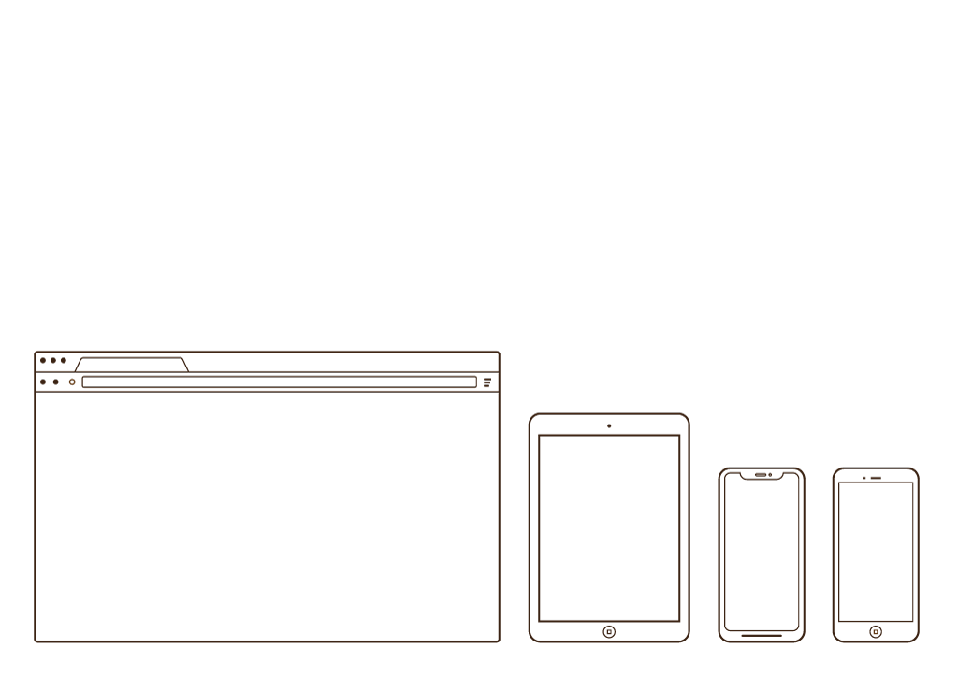
Responsive
web design
web
<web design module=”3”>

Slide 6
Responsive
web design
web
<web design module=”3”>
Setting the viewport on your HTML
<meta name="viewport" content="width=device-width, initial-scale=1.0">

Slide 7
Responsive
web design
web
<web design module=”3”>
Responsive Images using the width property
The CSS property is set to 100%. The image will scale up and down.

Slide 8
Responsive
web design
web
<web design module=”3”>
Example
<img src="img.jpg" style="width:100%;">

Slide 9
Responsive
web design
web
<web design module=”3”>
Responsive Images using the max-width property
The max-width property is set to 100%. The image will scale down, but never scale up to be larger than its original size.

Slide 10
Responsive
web design
web
<web design module=”3”>
Example
<img src="img.jpg" style="max-width:100%;height: auto;">

Slide 11
Responsive
web design
web
<web design module=”3”>
Responsive Images using the picture element
Allows you to define different images for different browser window sizes.

Slide 12
Responsive
web design
web
<web design module=”3”>
Example
<picture>
<source srcset="img_smallflower.jpg" media="(max-width: 600px)">
<source srcset="img_flowers.jpg" media="(max-width: 1500px)">
<source srcset="flowers.jpg">
<img src="img_smallflower.jpg" alt="Flowers">
</picture>

Slide 13
Responsive
web design
web
<web design module=”3”>
Responsive text size
The text size is set with a vw (viewport width).
<h1 style="font-size:10vw">Hello World</h1>
Note: vw - Relative to 1% of the width of the viewport
Notes:
Source: https://www.w3schools.com/cssref/css_units.asp

Slide 14
Responsive
web design
web
<web design module=”3”>
Responsive with media queries
You can define completely different styles for different browser sizes.
Notes:
https://www.w3schools.com/w3css/tryit.asp?filename=tryw3css_default_howto
https://www.w3schools.com/w3css/tryit.asp?filename=tryw3css_navigation_bar_mobile
https://www.w3schools.com/w3css/w3css_navigation.asp

